Slide 1
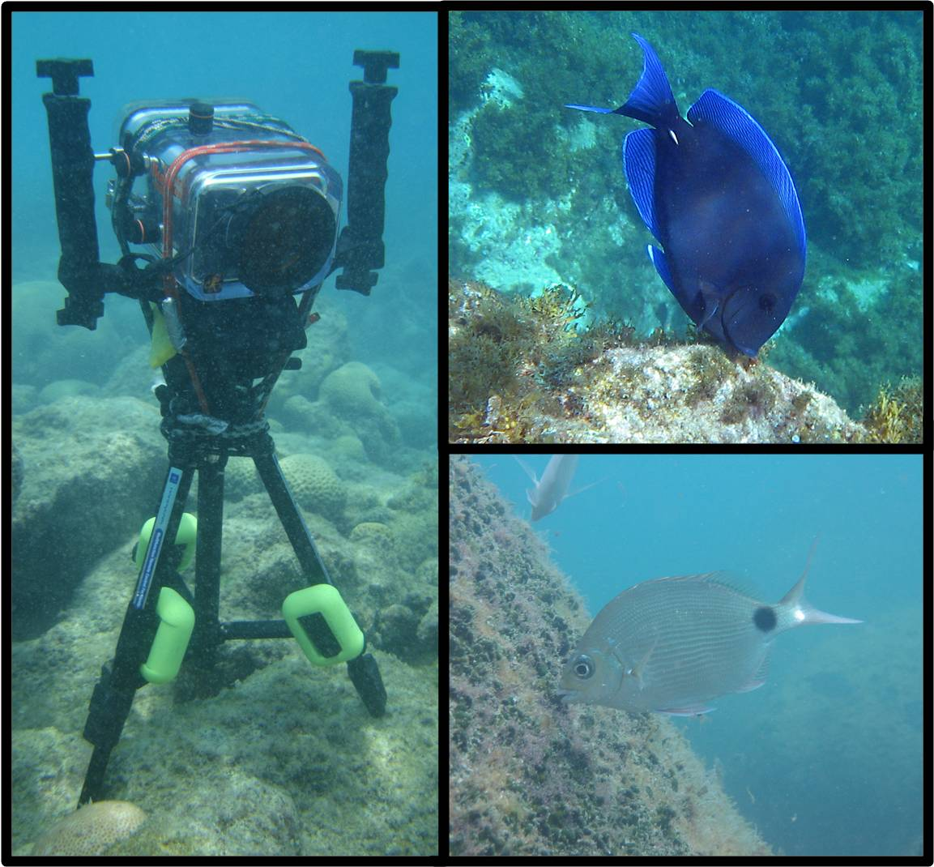
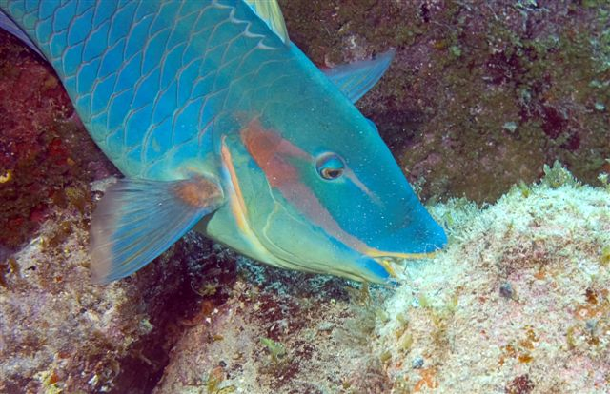
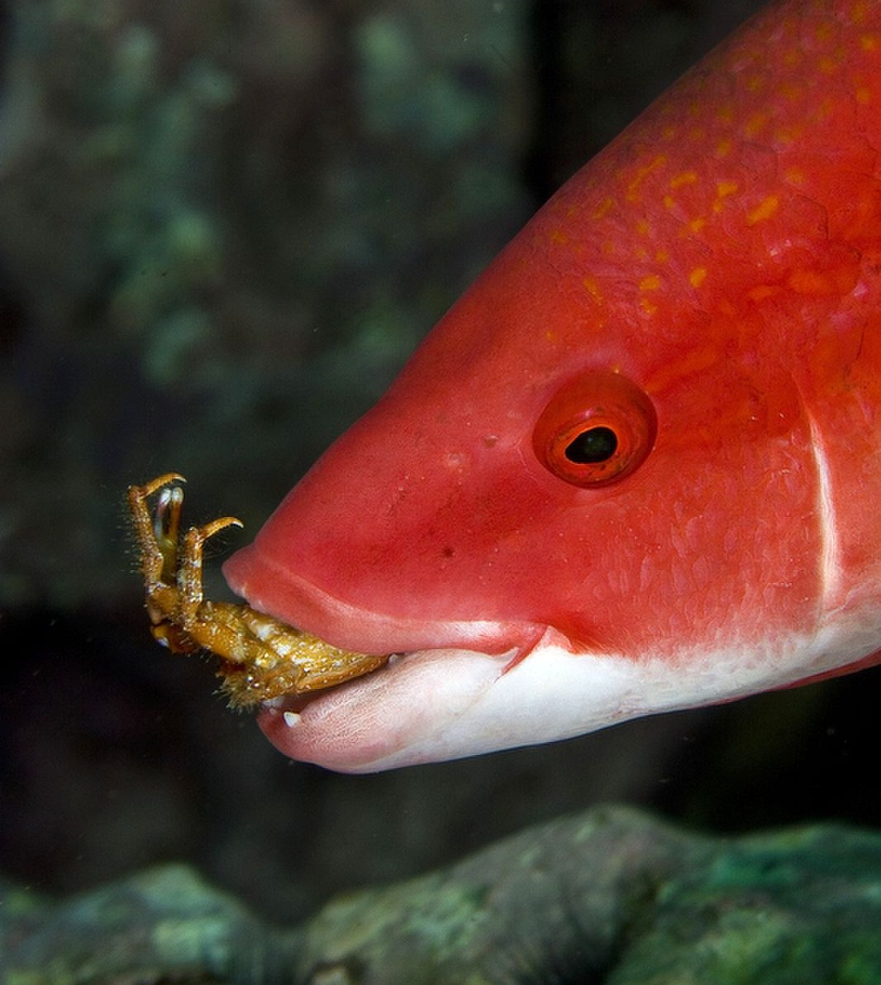
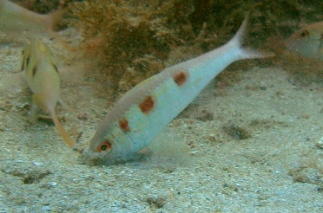



Reef fish feeding impact on benthos remarkably varies with latitude
Guilherme O. Longo
PhD Candidate, UFSC, Brazil
C.E.L. Ferreira, UFF, Brazil
S.R. Floeter, UFSC, Brazil
www.sisbiota.ufsc.br

Slide 2

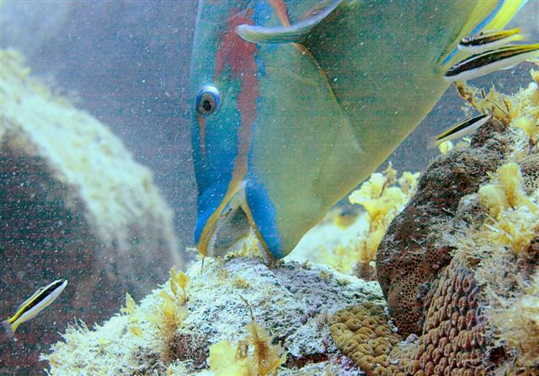
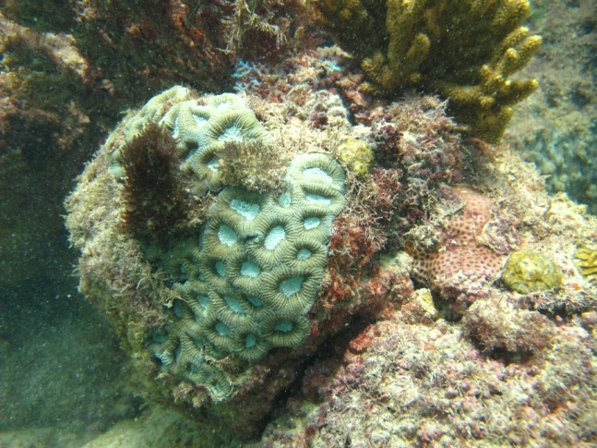
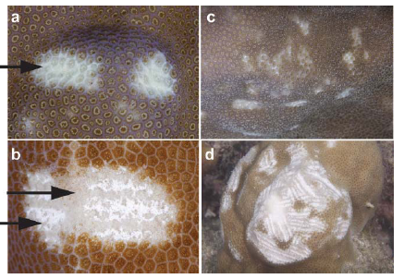
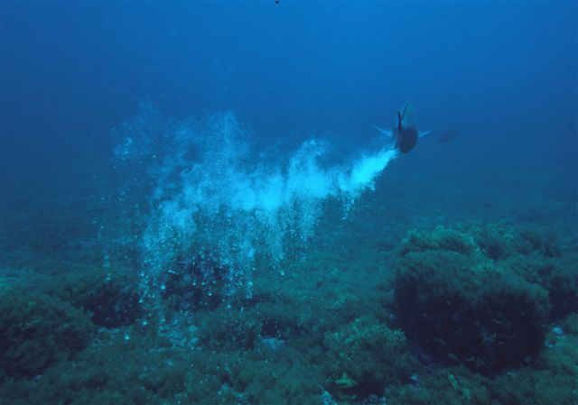
Why reef fish feeding impact on benthos?
Seaweed
Corals
Bioerosion
CaCo3
Hay 1997, Coral Reefs; Bellwood et al. 2003, Ecol Lett; Bonaldo et al. 2011, Coral Reefs
www.sisbiota.ufsc.br

Slide 3
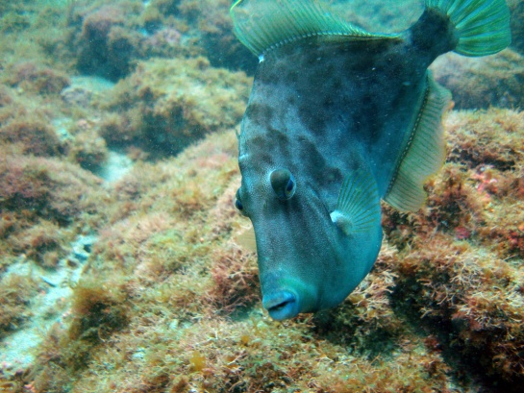
Why reef fish feeding impact on benthos?
Zoobenthivores
Indirect effects on benthic communities
e.g. Predation of mesograzers
Carpenter 1986, Ecol Monogr; McCormick 1995, Mar Biol
www.sisbiota.ufsc.br

Slide 4
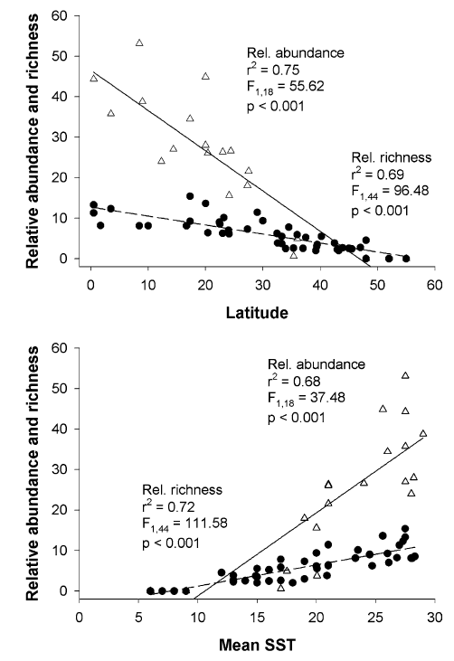
Why should it vary with latitude?
Latitude itself is not a causal factor
Water temperature
Species richness and
relative abundance
Species metabolism
Trophic structure
figure from Floeter et al. 2005, Mar Biol
www.sisbiota.ufsc.br

Slide 5
Why should it vary with latitude?
More active
Metabolic rate
Higher temperatures
Higher energetic demand
Water temperature
Feeding behaviour
Clarke & Johnston 1999,
J Animal Ecol
www.sisbiota.ufsc.br
Notes:
Since there is a correlation, then in higher temperatures

Slide 6
What do we know?
Focus only on herbivores
Diel feeding pattern
(e.g. Zemke-White et al. 2002, Mar Biol)
Seasonal variation
(e.g. Ferreira et al. 1998, J Fish Biol)
Across depth
(e.g. Fox & Bellwood 2007 et al., MEPS)
Across reef habitats
(e.g. Hoey & Bellwood 2008, Coral Reefs)
www.sisbiota.ufsc.br
Notes:
Therefore little is known about other trophic categories..

Slide 7
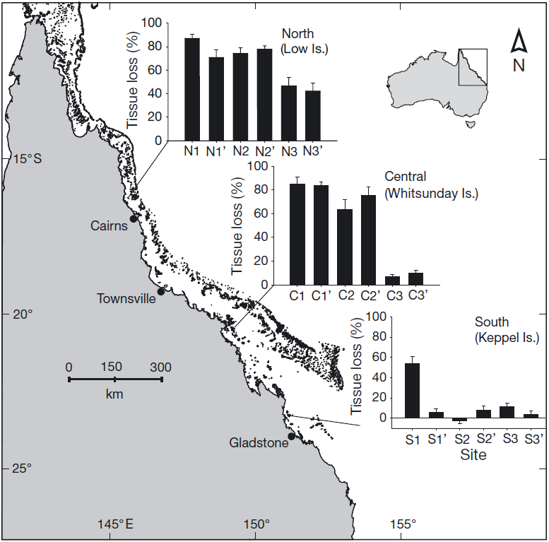
Identifying the gaps
Limited latitudinal comparisons
Still focused on herbivores
(e.g. Bennet & Bellwood 2011, MEPS)
figure from
Bennet & Bellwood 2011, MEPS
www.sisbiota.ufsc.br

Slide 8
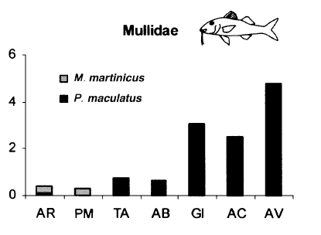
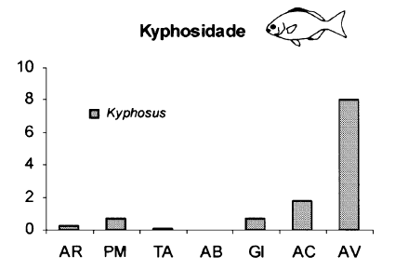
Identifying the gaps
Inferring function through
species abundance
(e.g. Ferreira et al. 2004, J Biogeogr)
Potential Bias
Latitude increases
figures from
Ferreira et al. 2004, J Biogeogr
www.sisbiota.ufsc.br
Notes:
Some studies that have tried to address other trophic categories are inferring function through species abundance.
Since species function might be disproportional to their abundance.

Slide 9
Aims
How reef fish feeding impact on benthos
varies with latitude?
Several reef fish functional groups within different trophic categories
How the total number of feeding interactions and feeding impact varies?
What is the contribution of different species and functional groups?
Is the species feeding impact proportional to its abundance?
sensu
Longo & Floeter in press
www.sisbiota.ufsc.br
Notes:
The aim of the study is to determine.

Slide 10
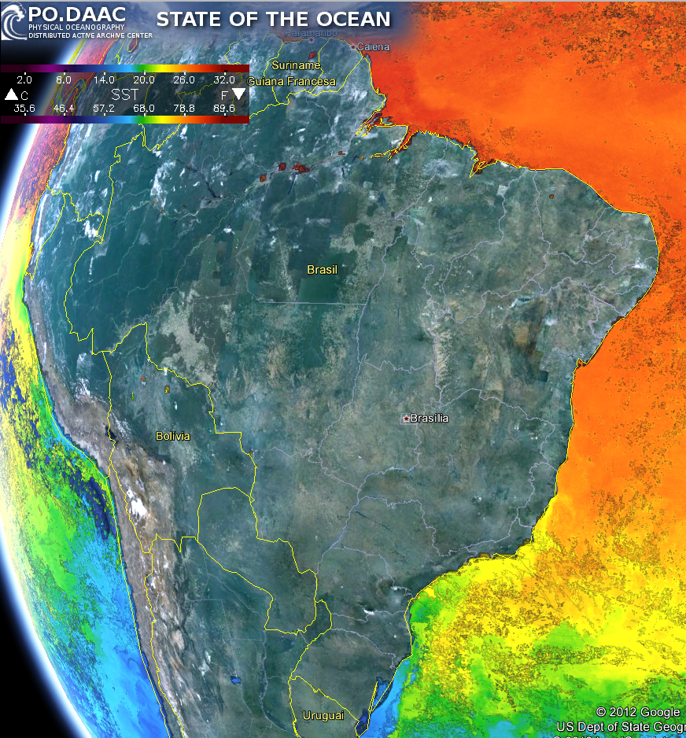
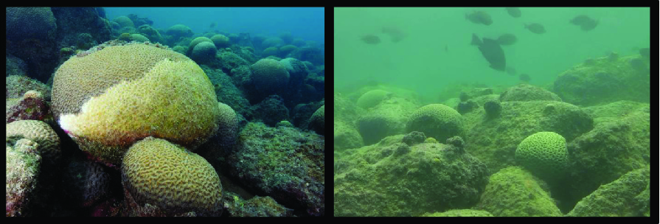
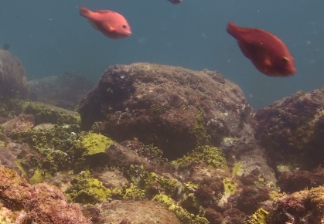
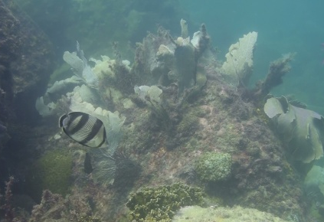
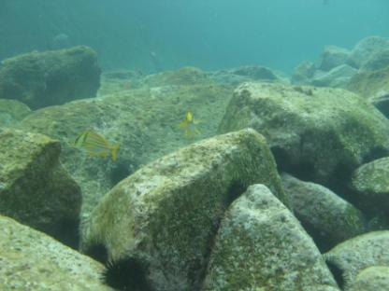
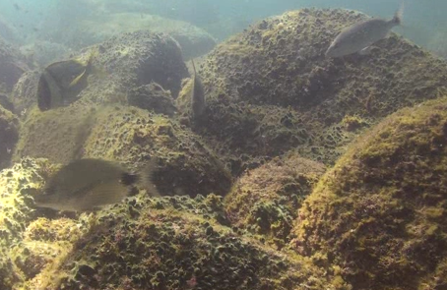
Methods
Broad latitudinal gradient
17-27 ° S
Abrolhos
SST 27.5 °C
Brazil
Arraial do Cabo
SST 24.5 °C
17° S
22° S
Santa Catarina
SST 22.5 °C
27° S
www.sisbiota.ufsc.br

Slide 11
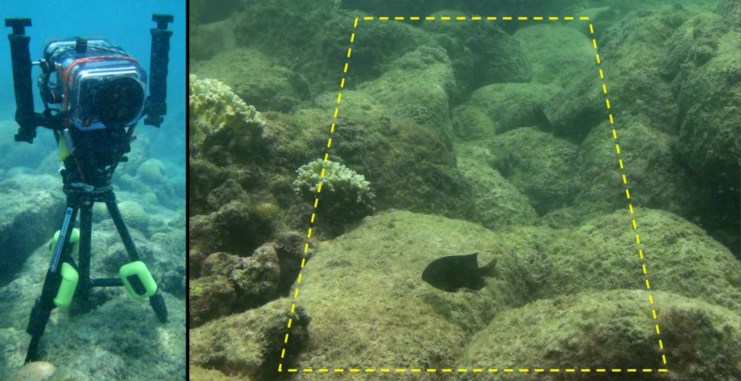
Methods
Video Assays
2m²
Replicated 2m² reef areas recorded for 10 minutes
Depth 4-12m
9:00 a.m. – 4:00 p.m.
sensu Longo & Floeter in press
www.sisbiota.ufsc.br

Slide 12
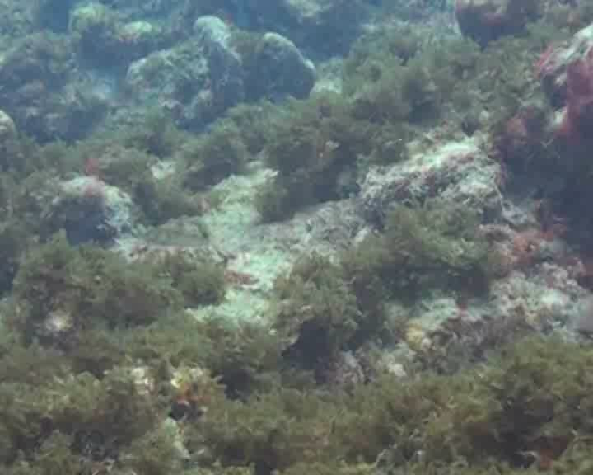
Methods
Several reef fish functional groups within different trophic categories
SPECIES
Mass standardized bite impact
SIZE CLASS
BITES x INDIVIDUAL BIOMASS
BITES
Longo & Floeter in press; Hoey & Bellwood 2009, Ecosystems
www.sisbiota.ufsc.br

Slide 13

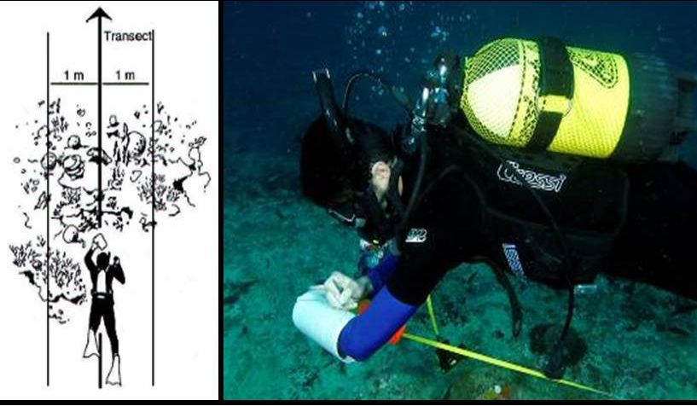
Methods
Reef fish community structure
UVC
20 x 2m = 40 m²
Species ID
Size classes
www.sisbiota.ufsc.br

Slide 14
Main findings
Number of feeding interactions
27.5° C
24.5° C
22.5° C
www.sisbiota.ufsc.br

Slide 15
Main findings
Feeding impact

Slide 16
Main findings
Functional Contribution
Fine Browsers
Scrapers
Omnivores
Scrapers
Omnivores
3%
Mobile Invertebrate
25
Herbivory decreases
Functional
dominance
10
5
www.sisbiota.ufsc.br

Slide 17
Main findings
Functional Contribution
All
Funtional Groups
25
10
5
www.sisbiota.ufsc.br

Slide 18
Main findings
Functional Contribution
Relative contribution
Increases
Absolute values
Similar
4
www.sisbiota.ufsc.br

Slide 19
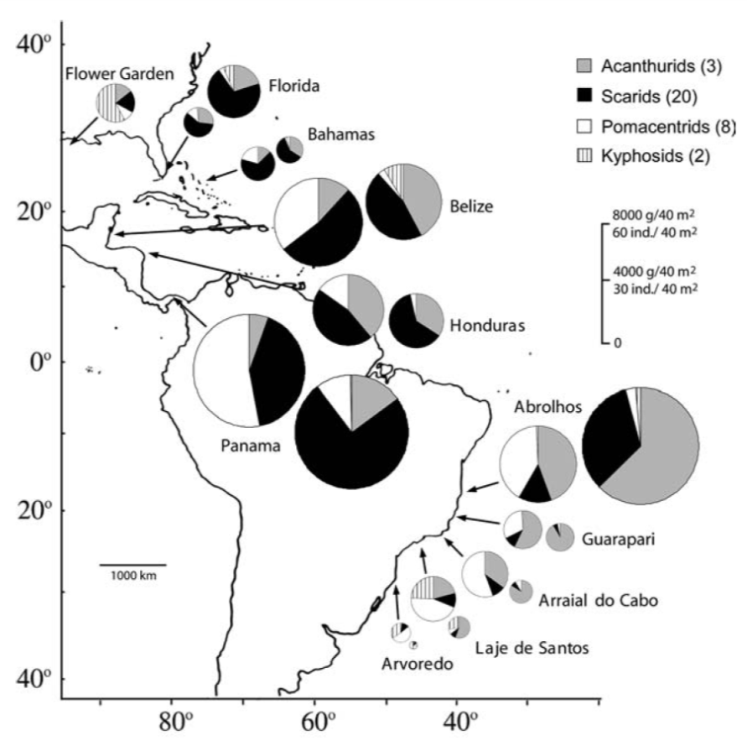
Discussion
What can species abundance tell?
Herbivores
Decrease contribution
Density and biomass
Composition
Floeter et al. 2005, Mar Biol
www.sisbiota.ufsc.br

Slide 20
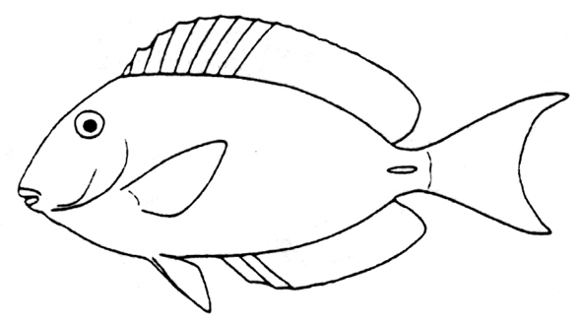

Main findings
Is the species feeding impact proportional to its abundance?
Abrolhos’ Archipelago
17°S
www.sisbiota.ufsc.br

Slide 21
Main findings
Is the species feeding impact proportional to its abundance?
Arraial do Cabo
22°S
www.sisbiota.ufsc.br

Slide 22
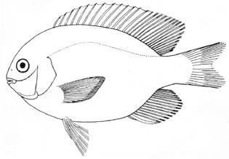
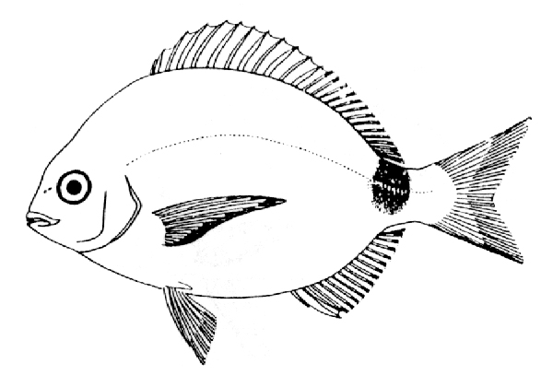
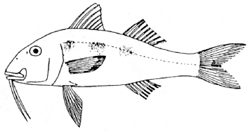

Main findings
Is the species feeding impact proportional to its abundance?
Santa Catarina
27°S
www.sisbiota.ufsc.br

Slide 23
“Take-home messages”
Reef fish feeding impact on benthos remarkably varies with latitude
1
Feeding rates and feeding impact decrease with latitude
2
Herbivory decreases with latitude
3
The proportional contributions of other trophic levels increase with latitude while the absolute contribution remains similar
4
Caution when inferring function through abundance
The feeding impact might not be directly correlated with species abundance
www.sisbiota.ufsc.br
Notes:
One must take caution when inferring function through abundance.

Slide 24




Acknowledgements
Fieldwork and video analysis
C.A.M. Cordeiro
D.R. Barneche
G. Correal
L. Fontoura
L.N. Teixeira
M. Levy
R. Mazzei
R.A. Morais
R. L-Bellas
R.M. Bonaldo
T.C. Mendes
Photographs
G.O. Longo, J.P. Krajewski, S.R. Floeter
www.sisbiota.ufsc.br

Slide 25
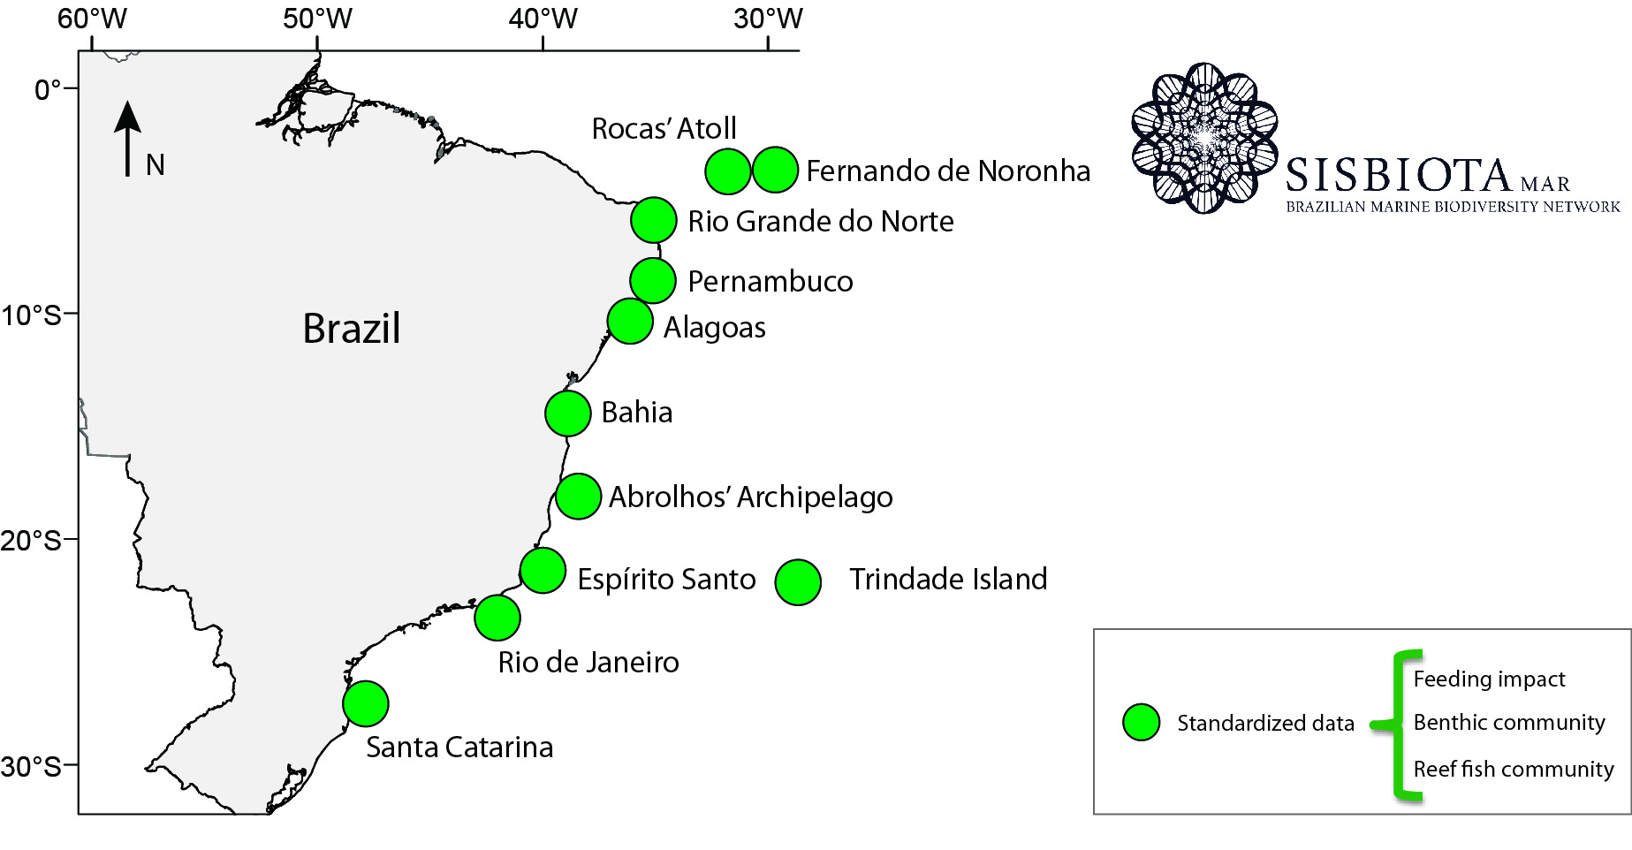
Next Steps
www.sisbiota.ufsc.br

